Slide 1
Lecture 11: Array and Vector – Part I
Class page: https://github.com/tsung-wei-huang/cs1410-40
Dr. Tsung-Wei Huang
Department of Electrical and Computer Engineering
University of Utah, Salt Lake City, UT
Notes:
Morning everyone
Today we are looking into control flow in C++.

Slide 2
Announcement
First midterm on 10/12 starting at the class time
Concept + Programming questions whatever we’ve covered
Due on 23:59 PM 10/18 (Sunday)
No lectures or Lab on the midterm week, but
We will have extra office hours at the scheduled class/lab time
We will help clarity your questions rather than give you solutions
Midterm will be take-home exam
Free to find solutions using the internet resource
Free to discuss solutions with your friends
NEVER JUST COPY SOLUTIONS
You can’t violate the rules of academic integrity
You are already undergraduates, be mature and responsible
Ultimately, it is your own knowledge, not mine

Slide 3
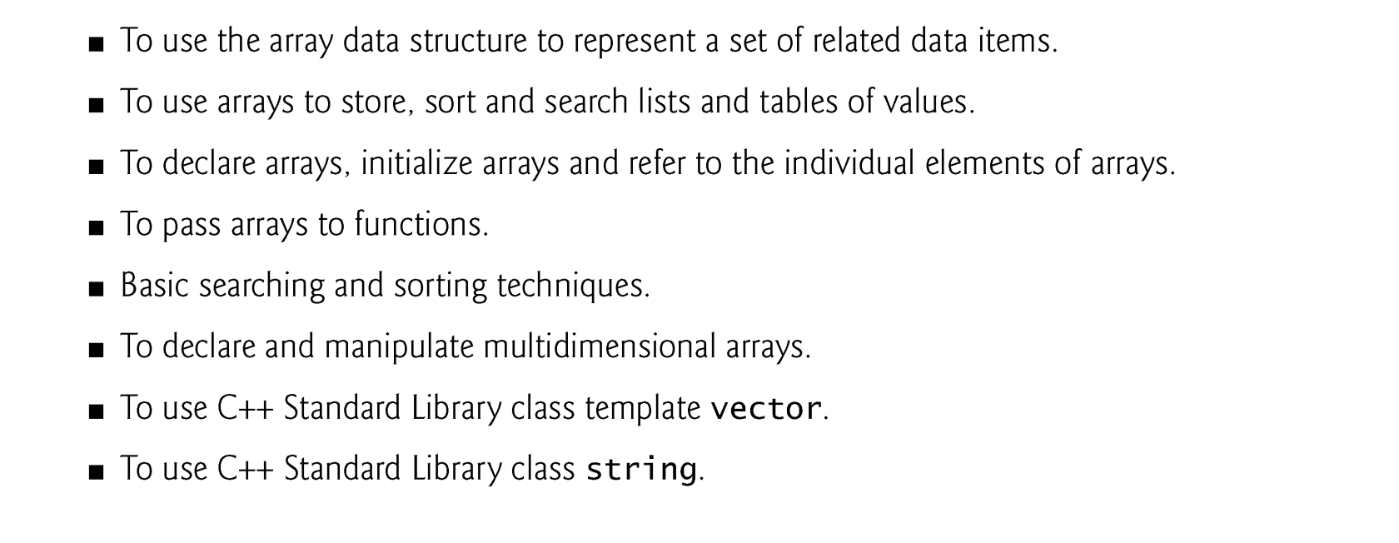
Learning Objective

Slide 4
Array
An array is a consecutive group of memory locations that all have the same type.
To refer to a particular location or element in the array, specify the name of the array and the position number of that element.
The position number is formally called a subscript or index.
This number specifies the number of elements from the beginning of the array.
A subscript must be an integer or integer expression (using any integral type).
The first element in every array has subscript 0 (zero) and is sometimes called the zeroth element.

Slide 5
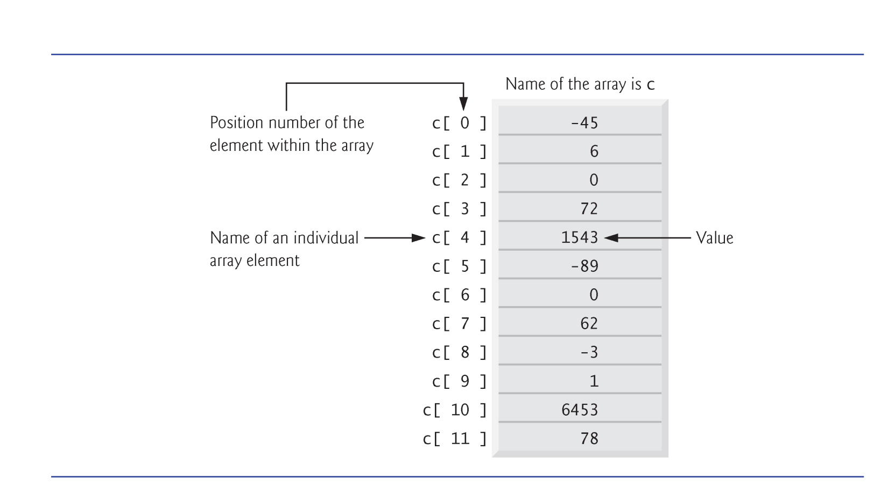
Memory Layout of Array

Slide 6
Declaring an Array
Arrays occupy space in memory.
To specify the type of the elements and the number of elements required by an array use a declaration of the form:
type arrayName[ arraySize ];
Ex: int n[5]; → 5 integer elements
The compiler reserves the appropriate amount of memory.
All elements are put in a continuous memory space.

Slide 7
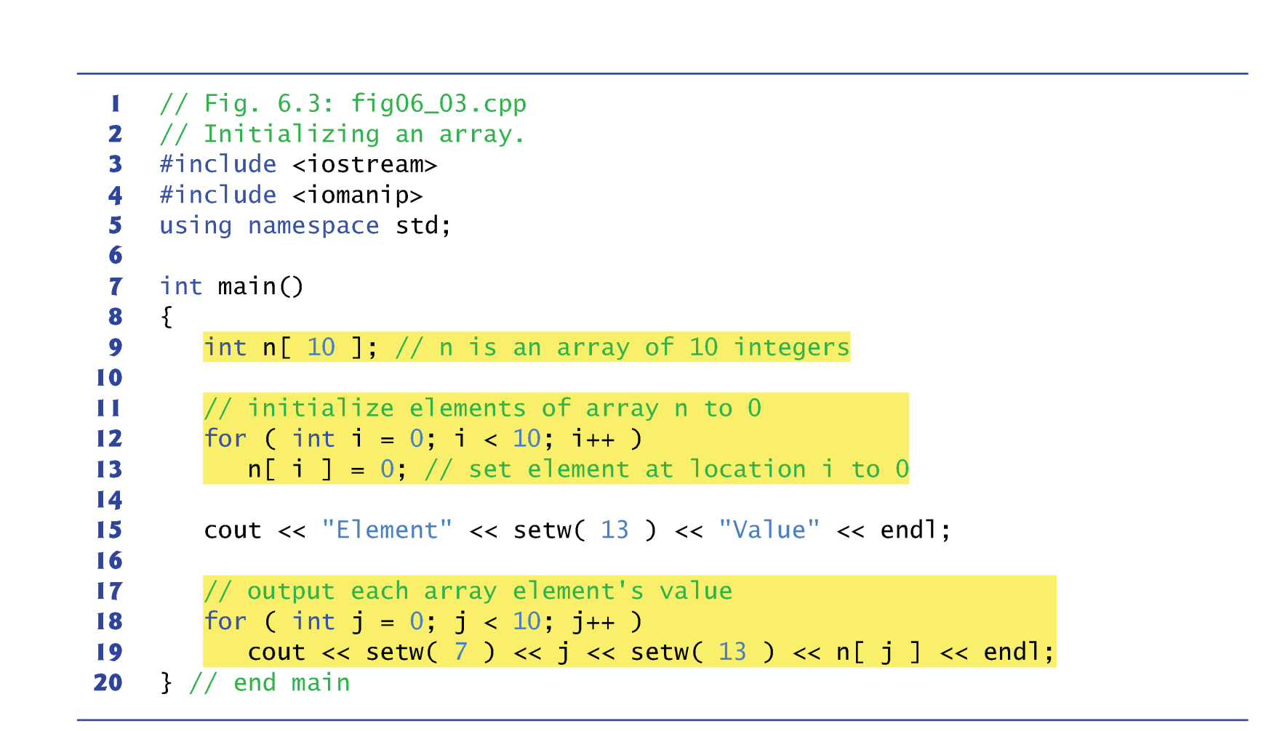
Array Example

Slide 8
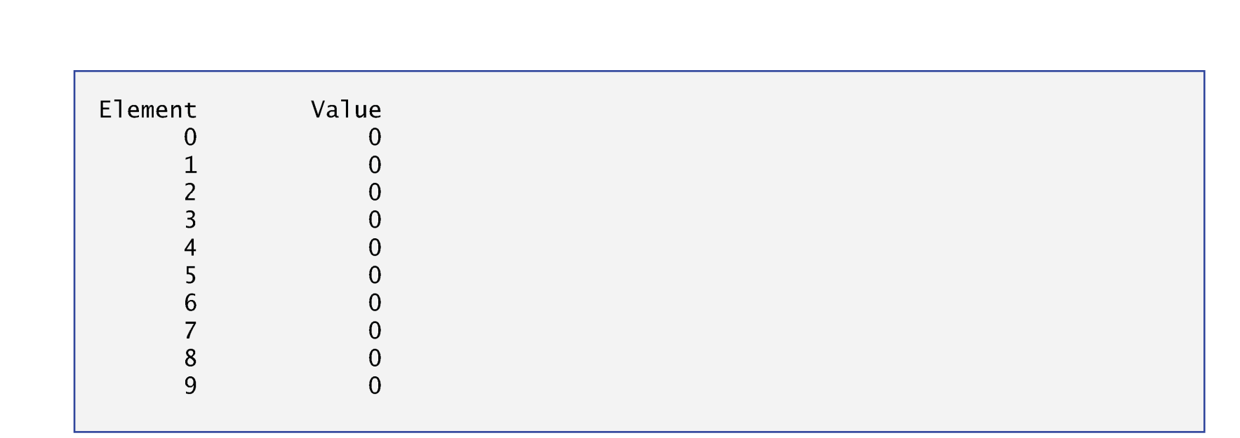
Array Example

Slide 9
Initializing an Array
The elements of an array also can be initialized by a brace-delimited comma-separated list of initializers.
The previous program uses an initializer list to initialize an integer array with 10 values (line 10).
If there are fewer initializers than elements in the array, the remaining array elements are initialized to zero.
If the array size is omitted from a declaration with an initializer list, the compiler determines the array size automatically
By counting the number of elements in the initializer list.
Ex: int n[] = {1,2,3,4,5}; → 5 elements

Slide 10
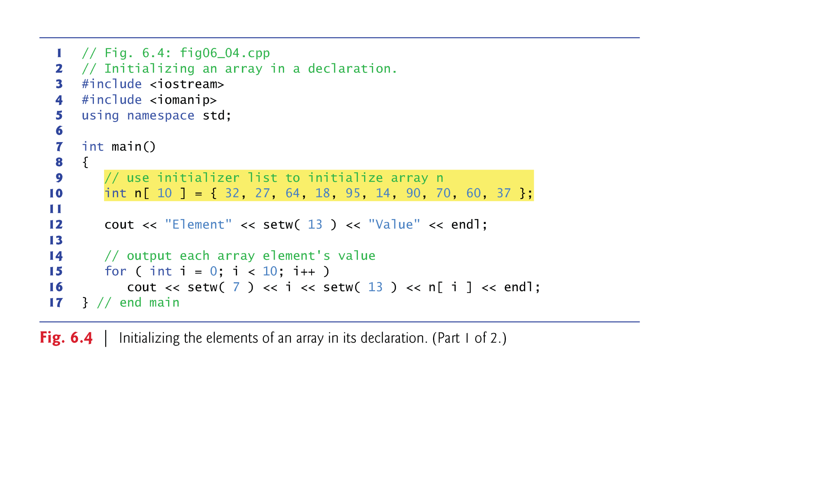
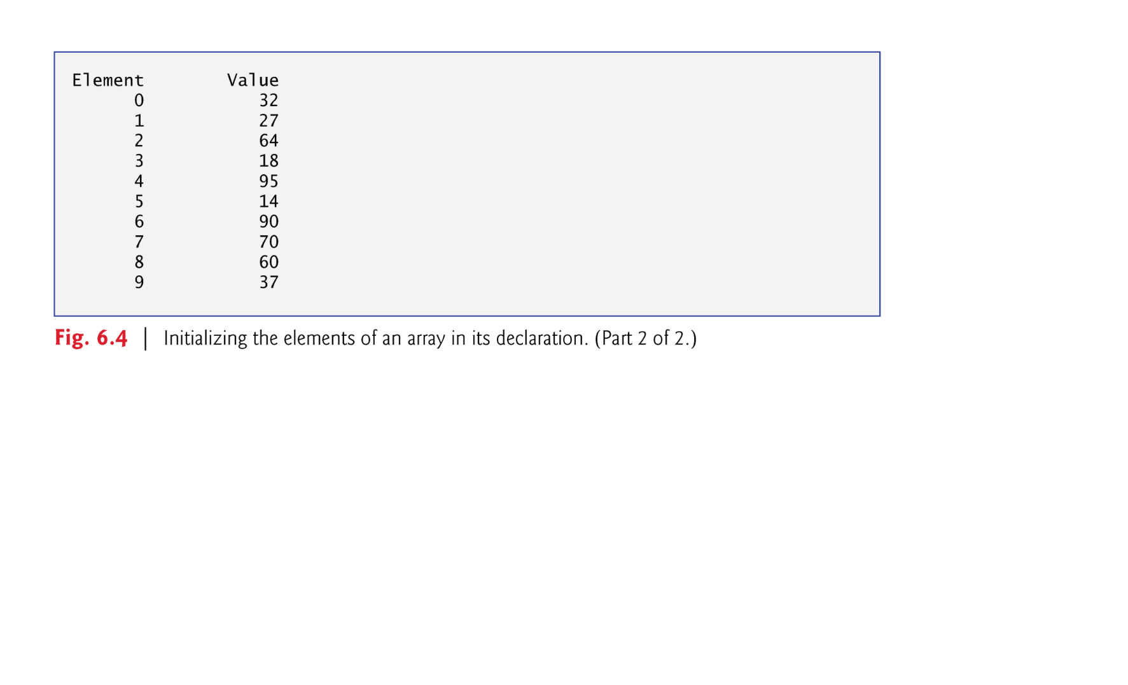
Example: Initializing an Array

Slide 11
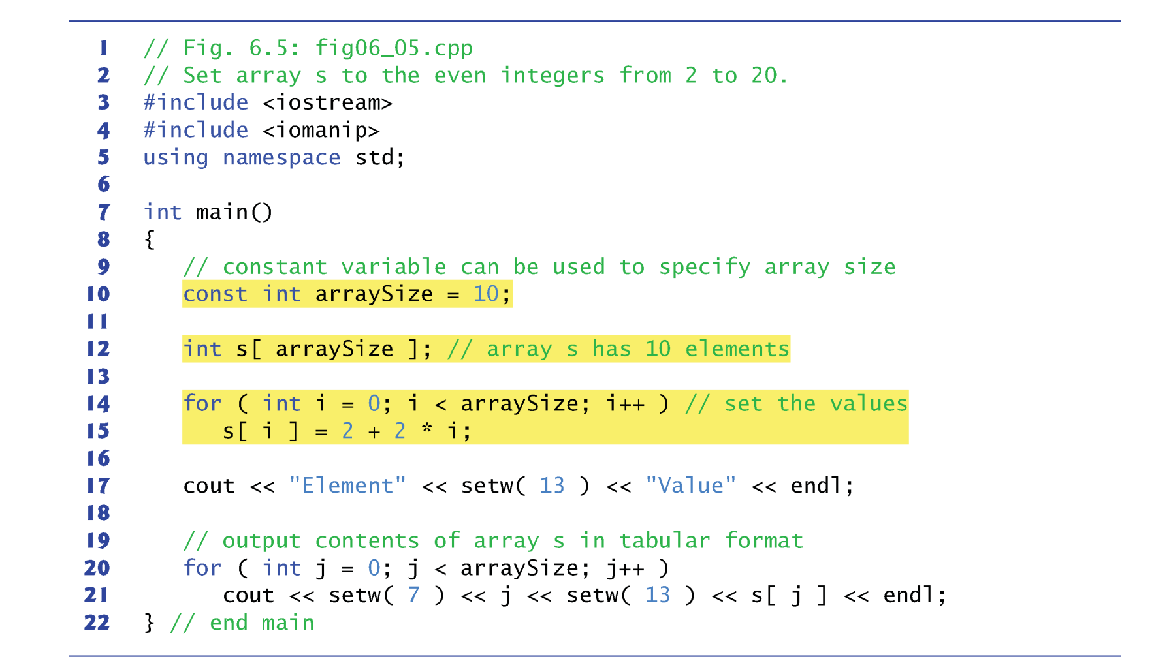
Specify the Array Size

Slide 12
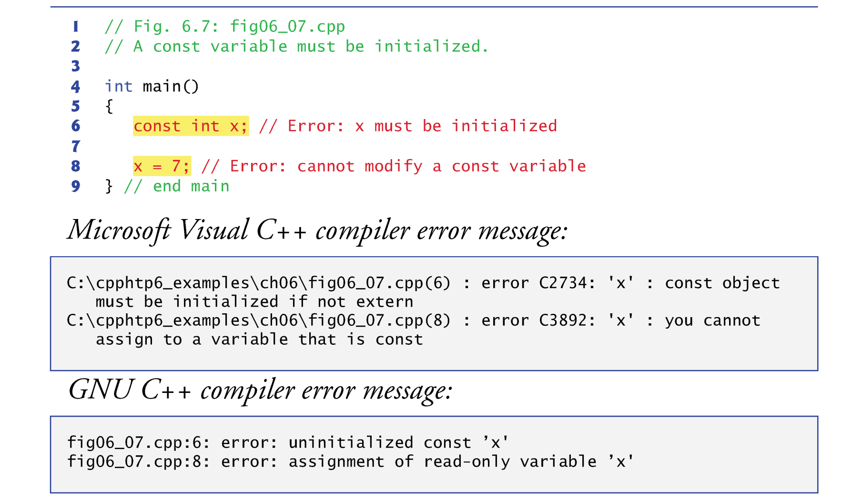
const Qualifier

Slide 13
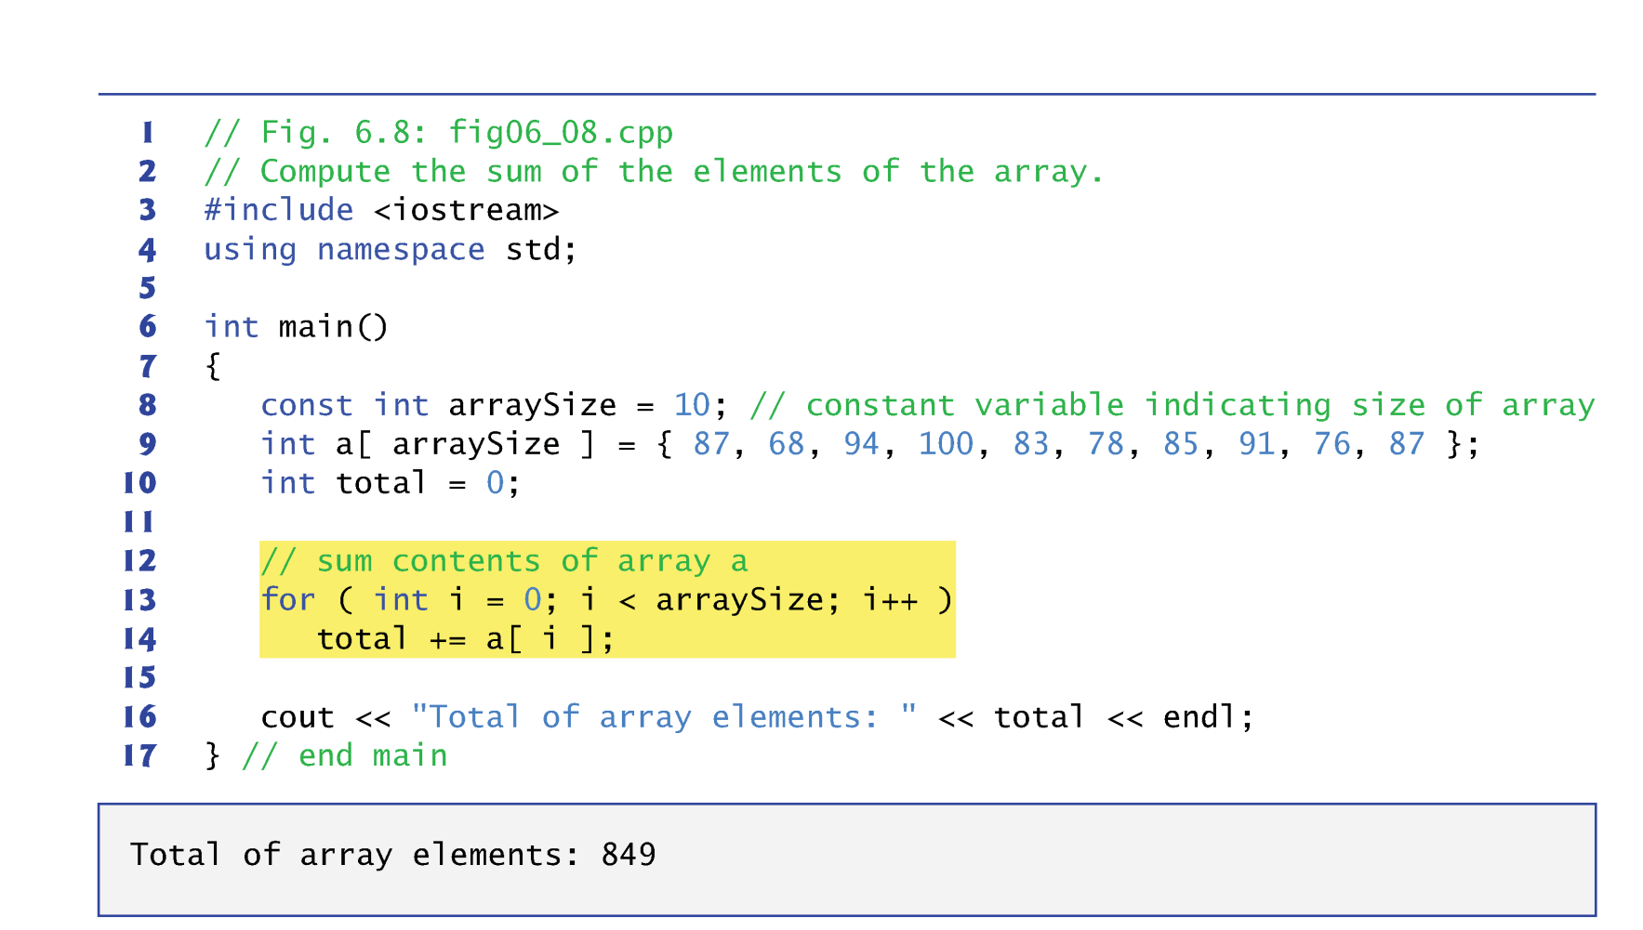
Practice 1: Summing Elements in an Array

Slide 14
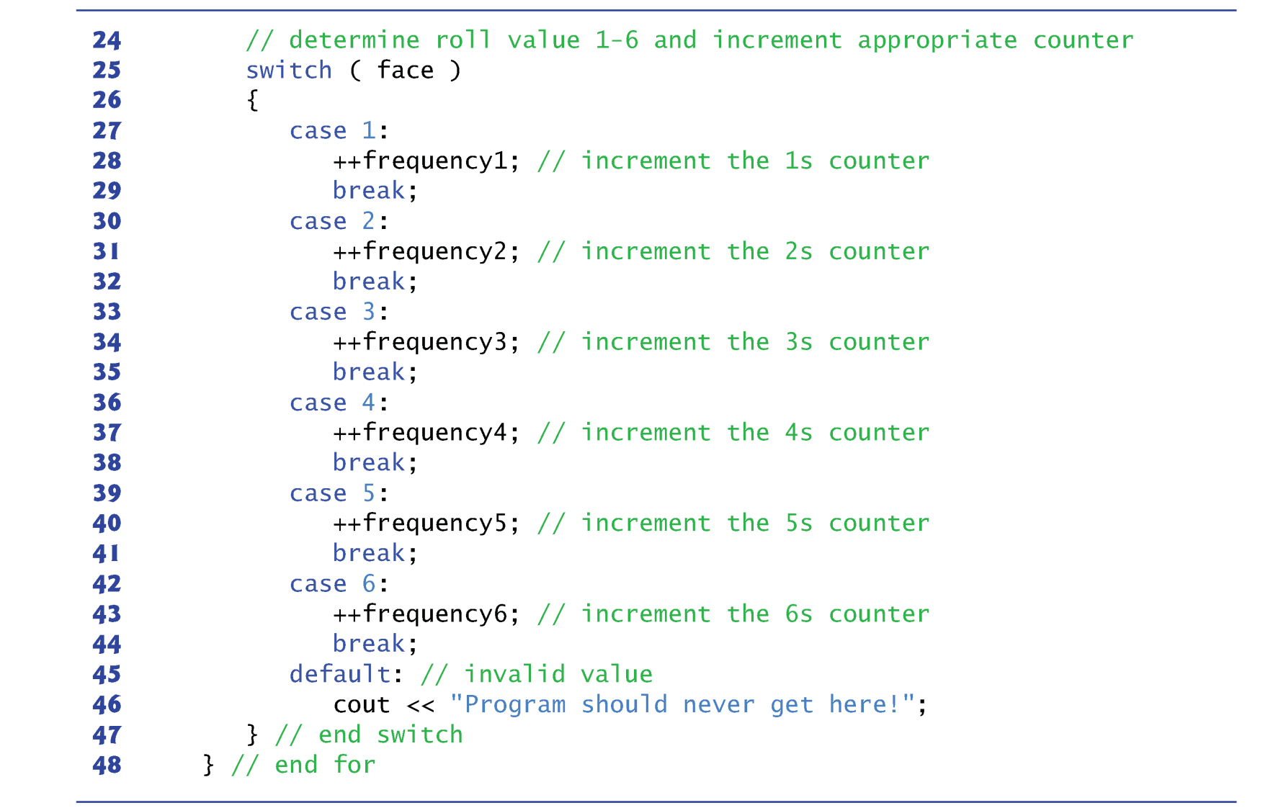
Practice 2: Array as Counter
Sometimes, programs use counter variables to summarize data, such as the results of a survey.
In previous die-rolling program, we used separate counters to track the number of occurrences of each side of a die.

Slide 15
C++ STL Vector
C-style pointer-based arrays have great potential for errors and are not flexible
A program can easily “walk off” either end of an array, because C++ does not check whether subscripts fall outside the range of an array.
Two arrays cannot be meaningfully compared with equality operators or relational operators.
The size of the array must be passed as an additional argument when an array is passed to a general-purpose function.
One array cannot be assigned to another with the assignment operator(s).
C++ Standard class template vector represents a more robust type of array featuring many additional capabilities.
Defined in header <vector> and belongs to namespace std.

Slide 16
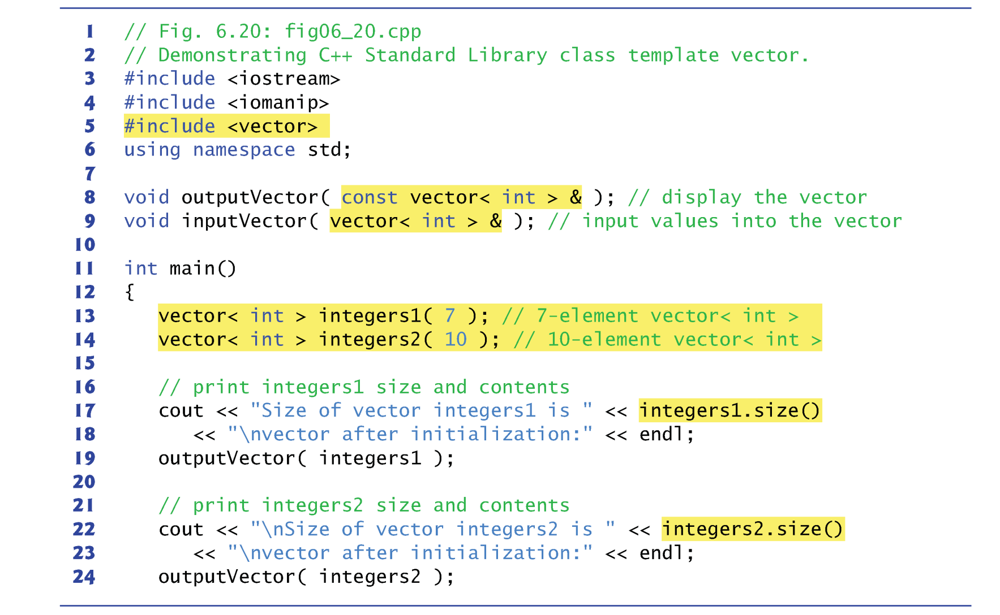
Vector Example

Slide 17
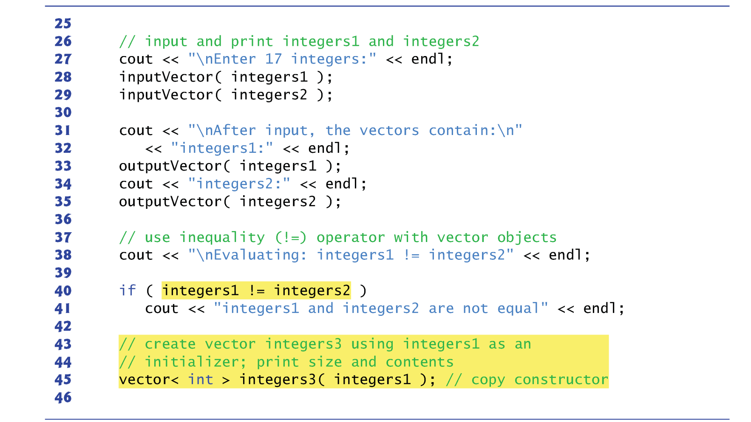
Vector Example

Slide 18
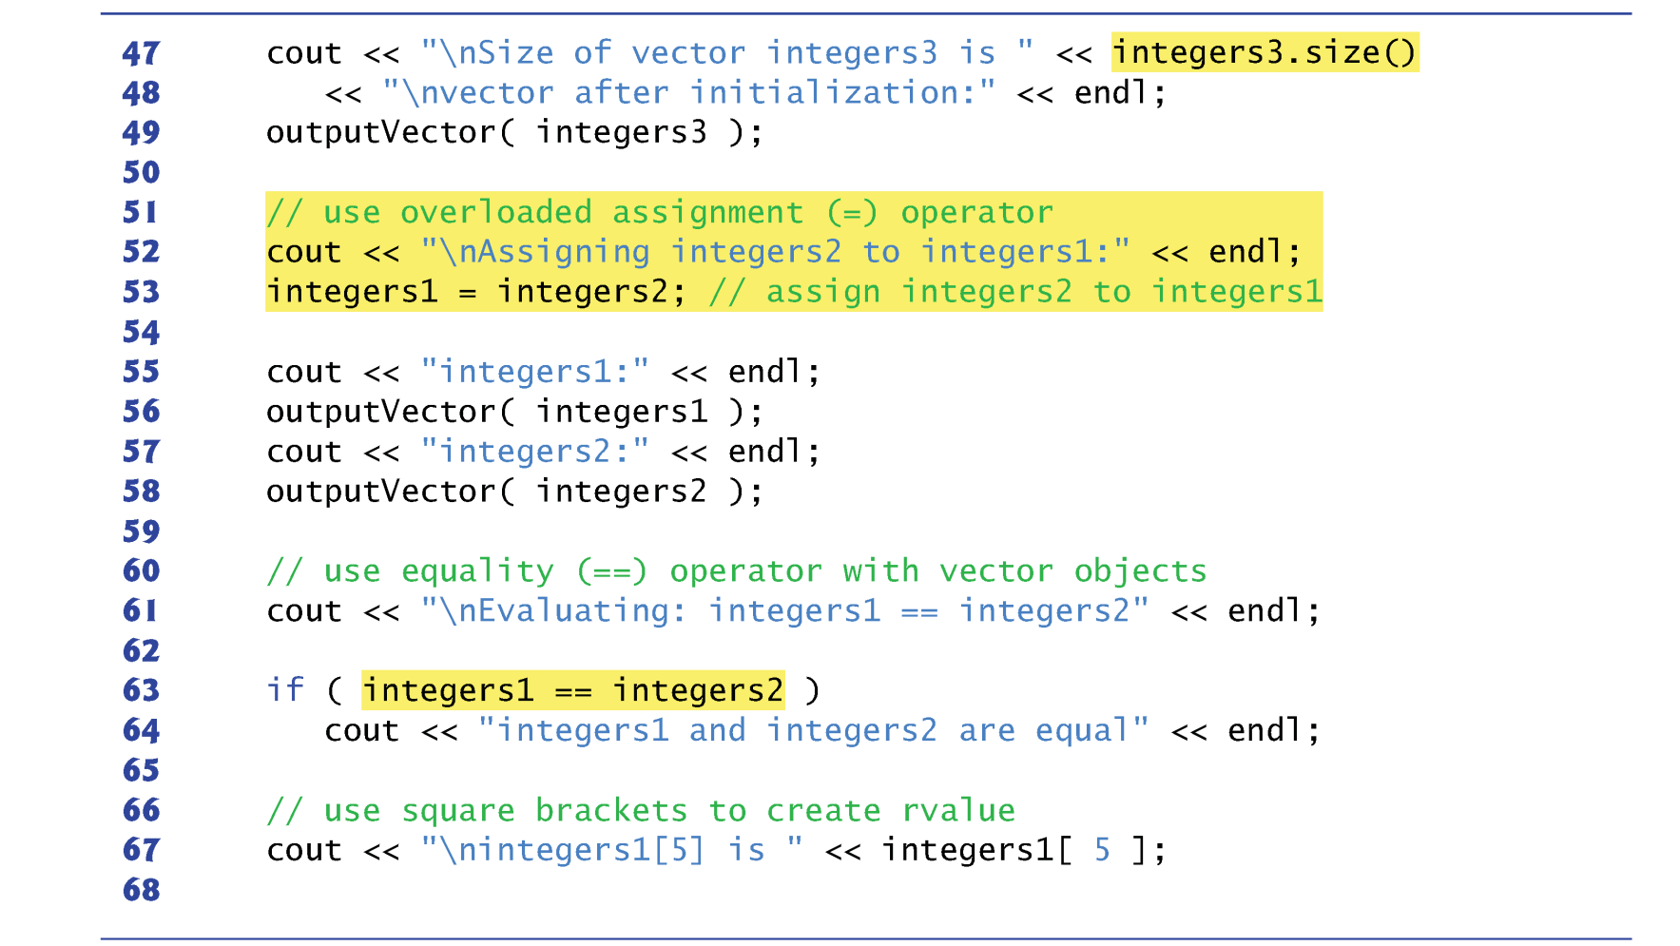
Vector Example

Slide 19
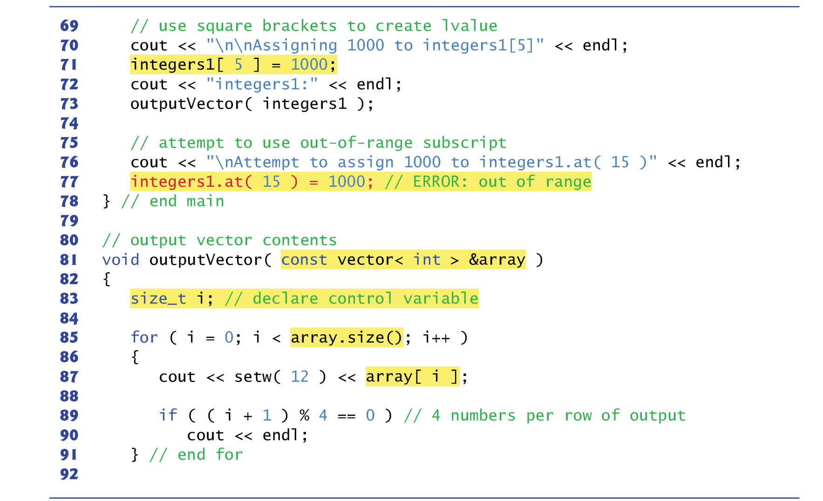
Vector Example

Slide 20
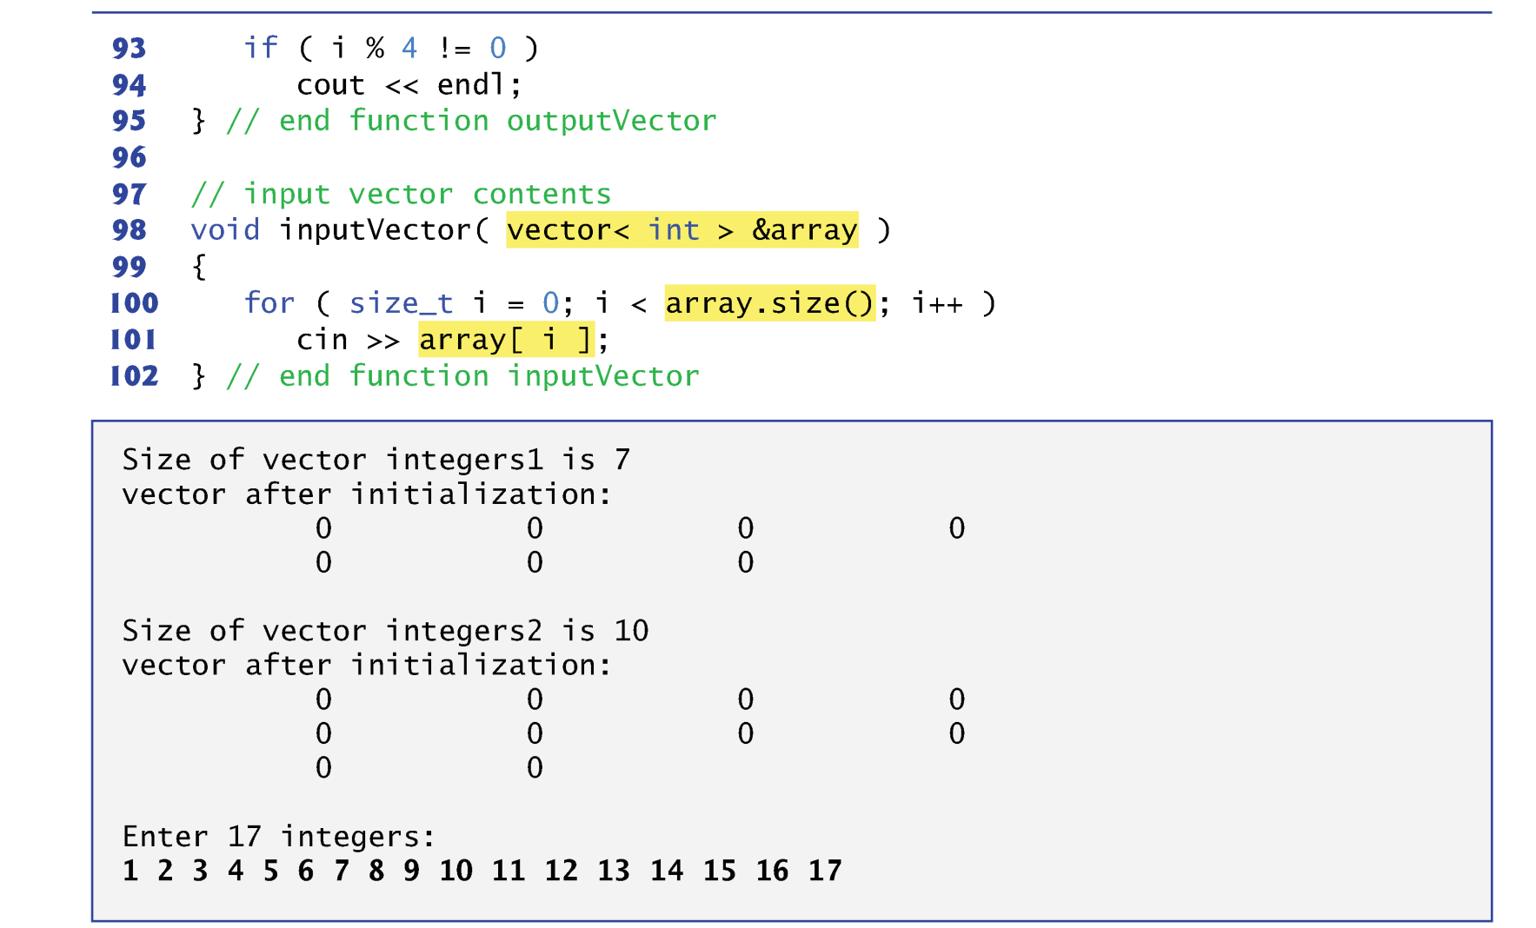
Vector Example

Slide 21
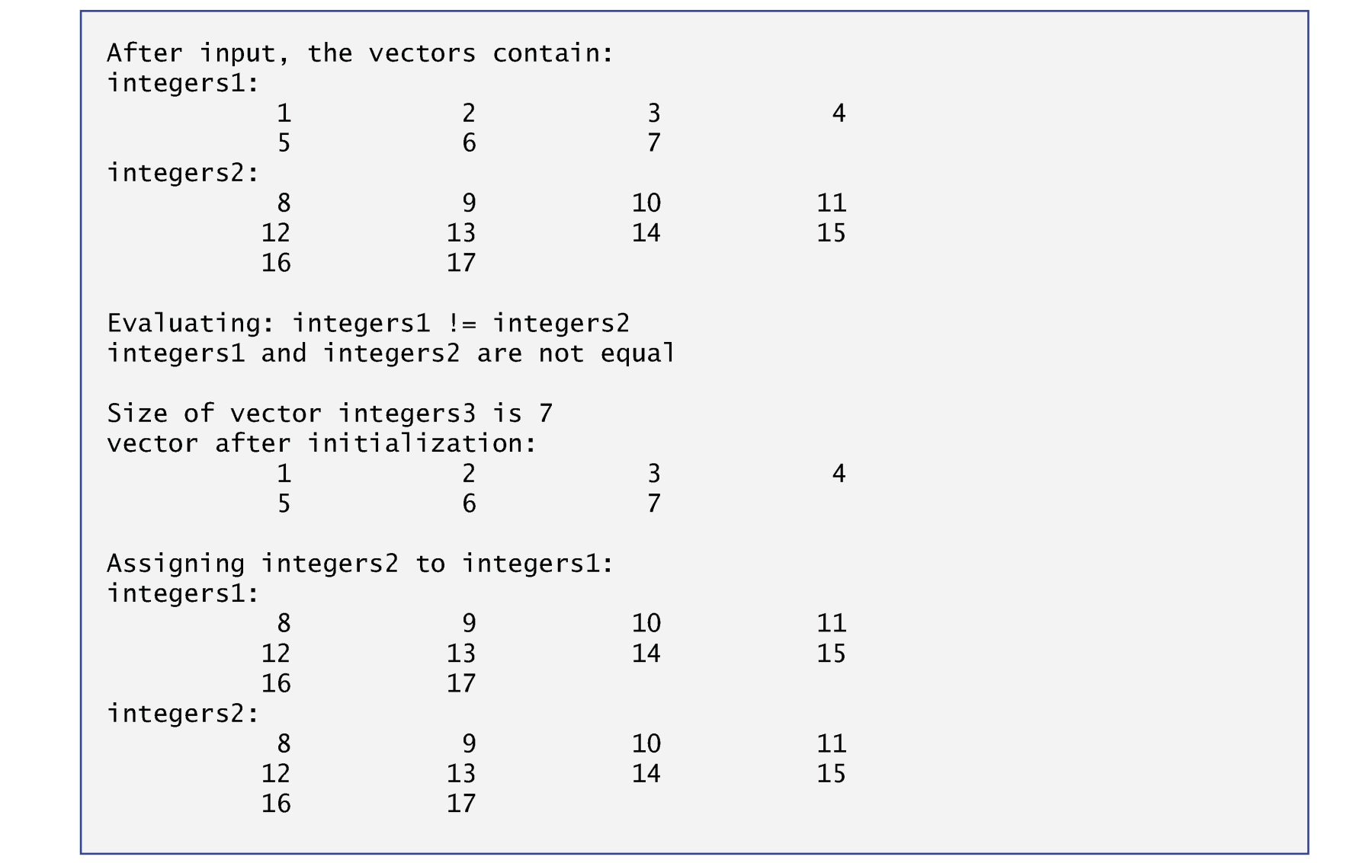
Vector Example

Slide 22
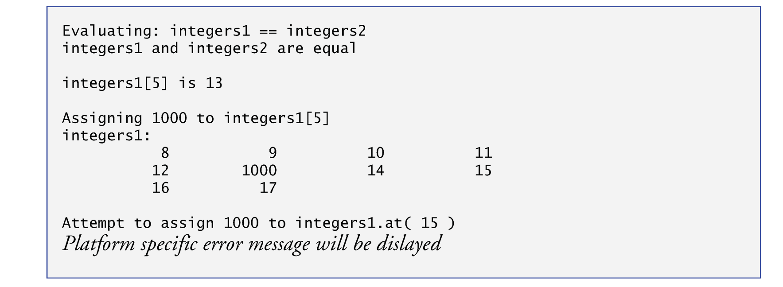
Vector Example

Slide 23
C++ STL Vector
By default, all the elements of a vector object are set to 0.
vectors can be defined to store any data type.
vector member function size obtain the number of elements in the vector.
You can use square brackets, [], to access the elements in a vector.
vector objects can be compared with one another using the equality operators.
You can create a new vector object that is initialized with a copy of an existing vector.

Slide 24
Summary
C-styled Array Syntax
C++ STL Vector
First midterm on 10/12 starting at the class time
Concept + Programming questions whatever we’ve covered
Due on 23:59 PM 10/18 (Sunday)
No lectures or Lab on the midterm week, but
We will have extra office hours at the scheduled class/lab time
We will help clarity your questions rather than give you solutions
Midterm will be take-home exam
Free to find solutions using the internet resource
Free to discuss solutions with your friends
NEVER JUST COPY SOLUTIONS
You can’t violate the rules of academic integrity
You are already undergraduates, be mature and responsible
Ultimately, it is your own knowledge, not mine

